Slide 1






LA Crime Data Analysis Diya Baldota - 002747966 Veenadharini Shukla - 002704948

Slide 2
Background & Goal
As crime continues to plague many cities around the globe, law enforcement agencies are constantly searching for innovative ways to address this issue. Los Angeles, a city that has experienced a steady increase in various forms of crime, such as theft, assault, and homicide, is at the forefront of this battle. These crimes not only endanger lives and property but also place a heavy burden on the city's resources and public safety infrastructure.

Slide 3
Methodology
Data exploration and understanding
Data Cleaning
Removing irrelevant or redundant data
Handling Missing Values
Data validation and quality assurance
Documentation and reproducibility
Additional steps for specific columns

Slide 4
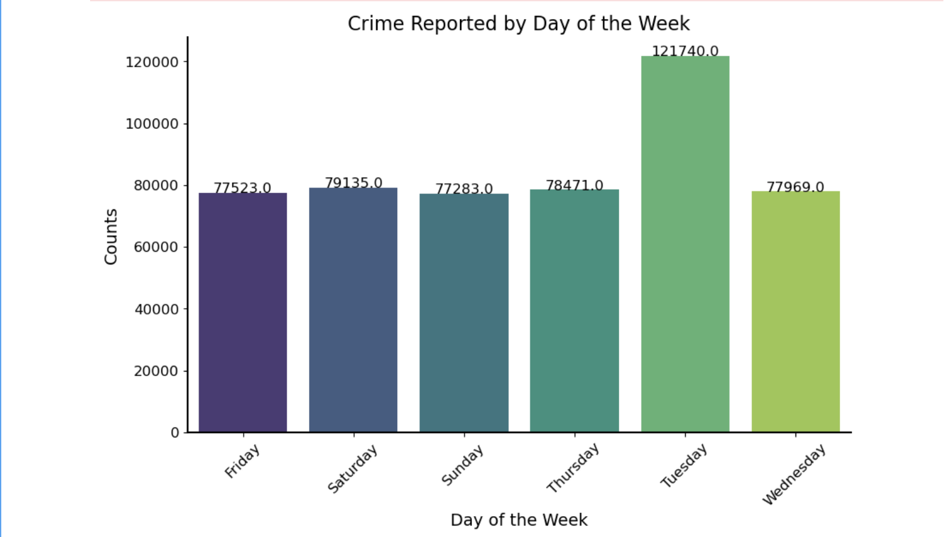
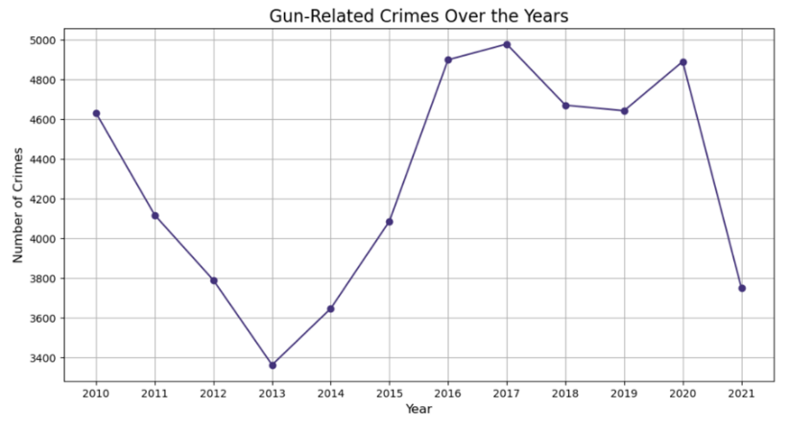
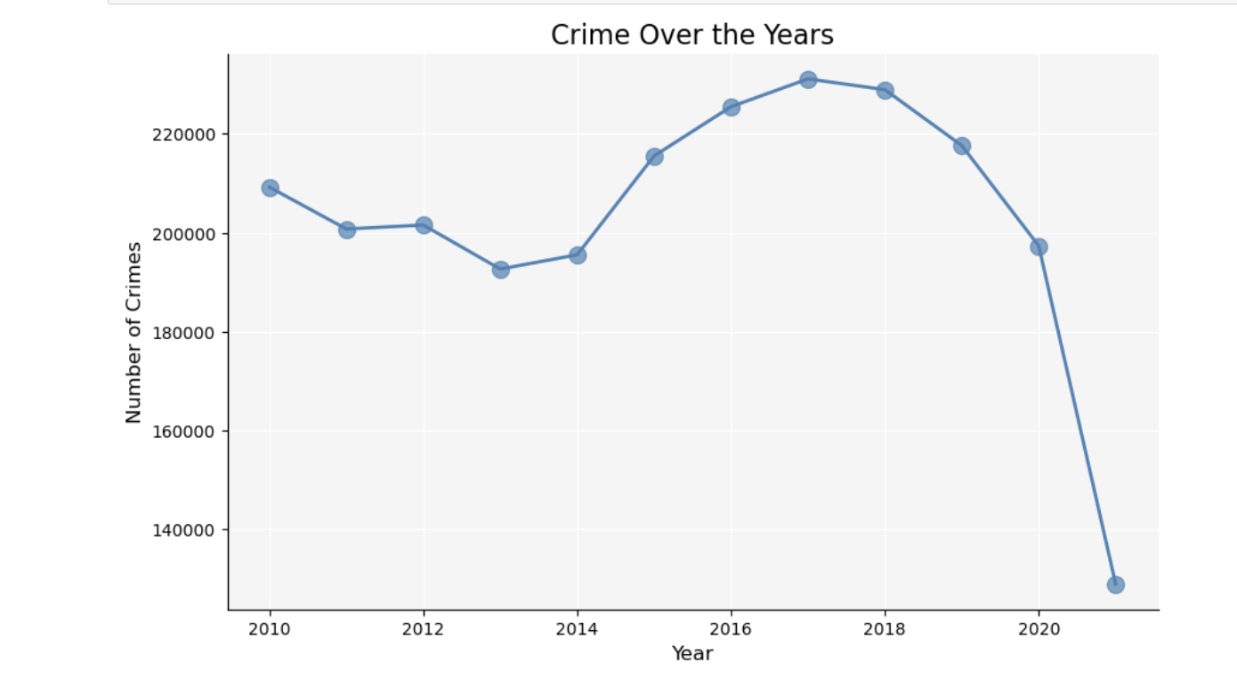
Exploratory Data Analysis

Slide 5
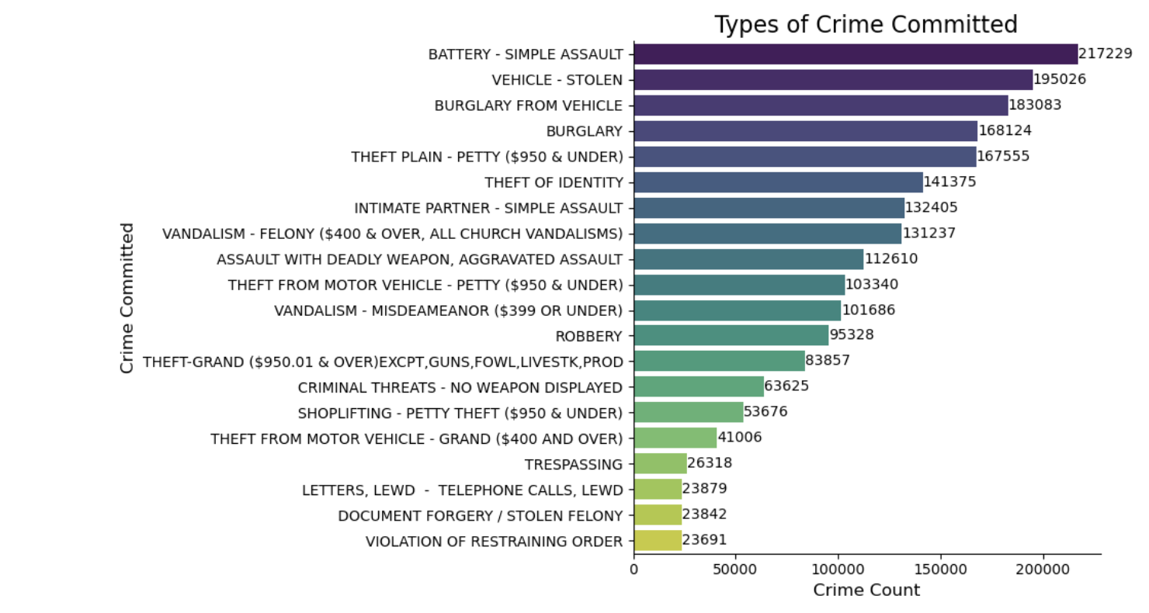
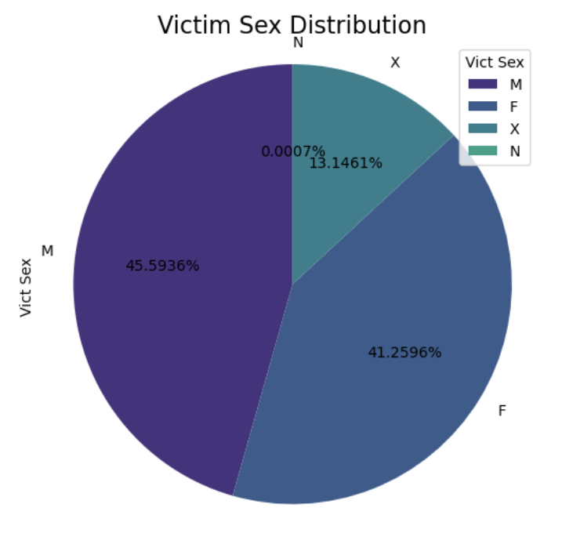
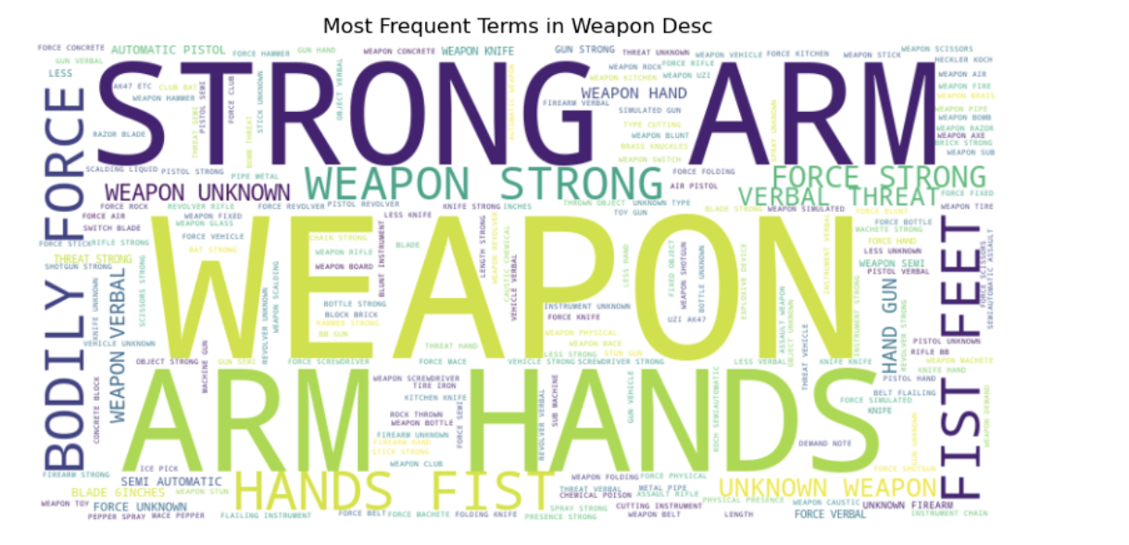
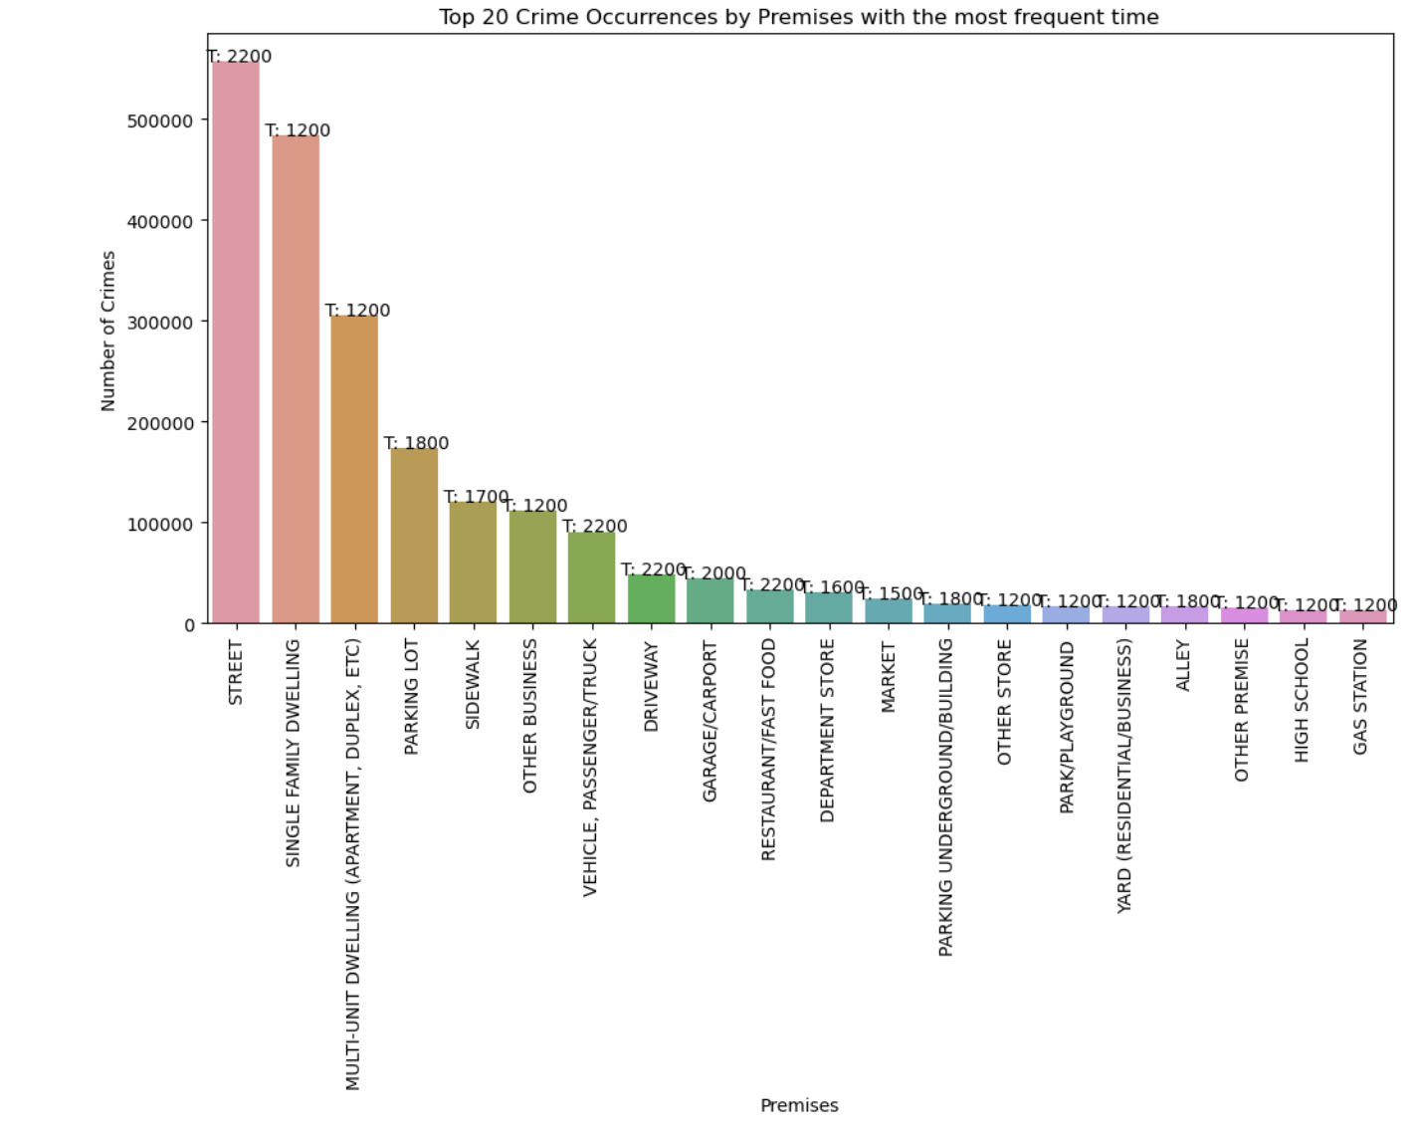

Slide 6
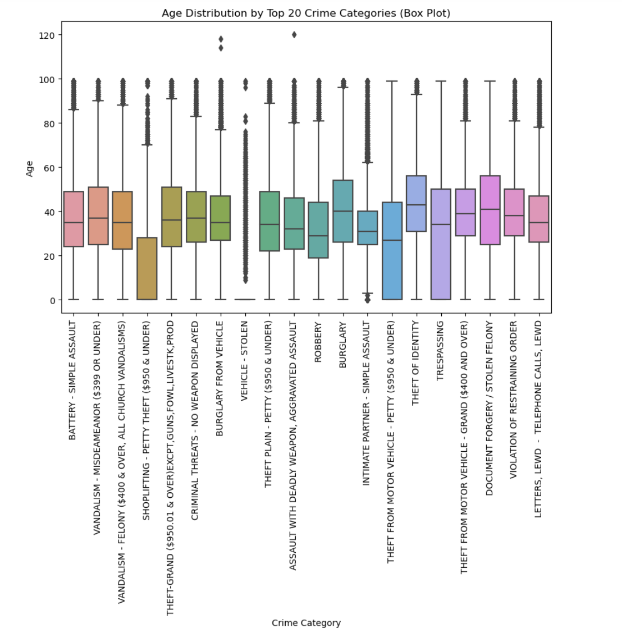
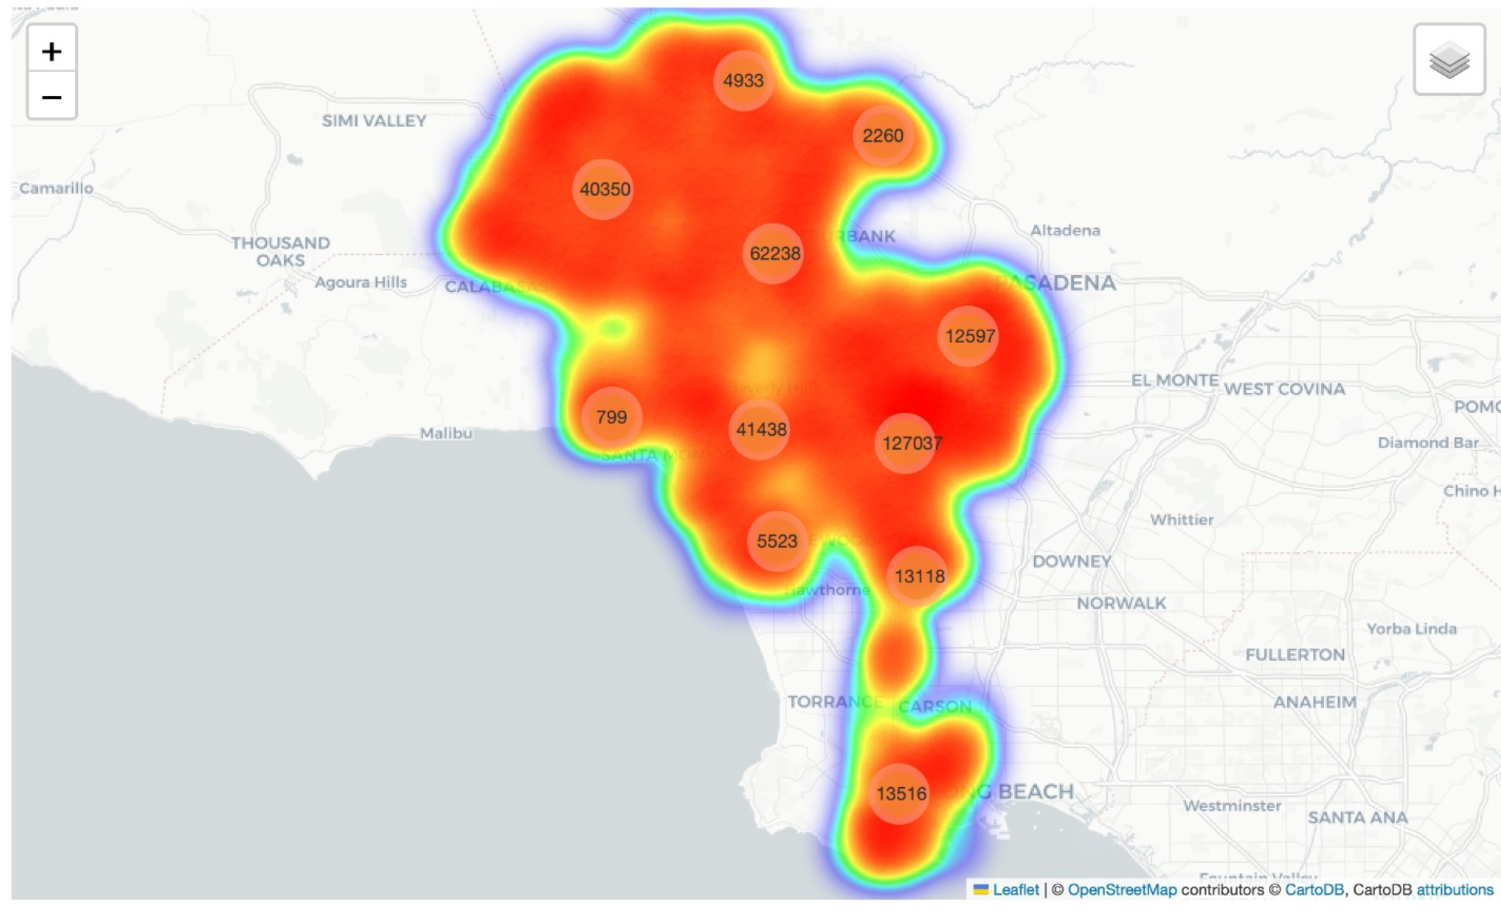
Exploratory Data Analysis

Slide 7
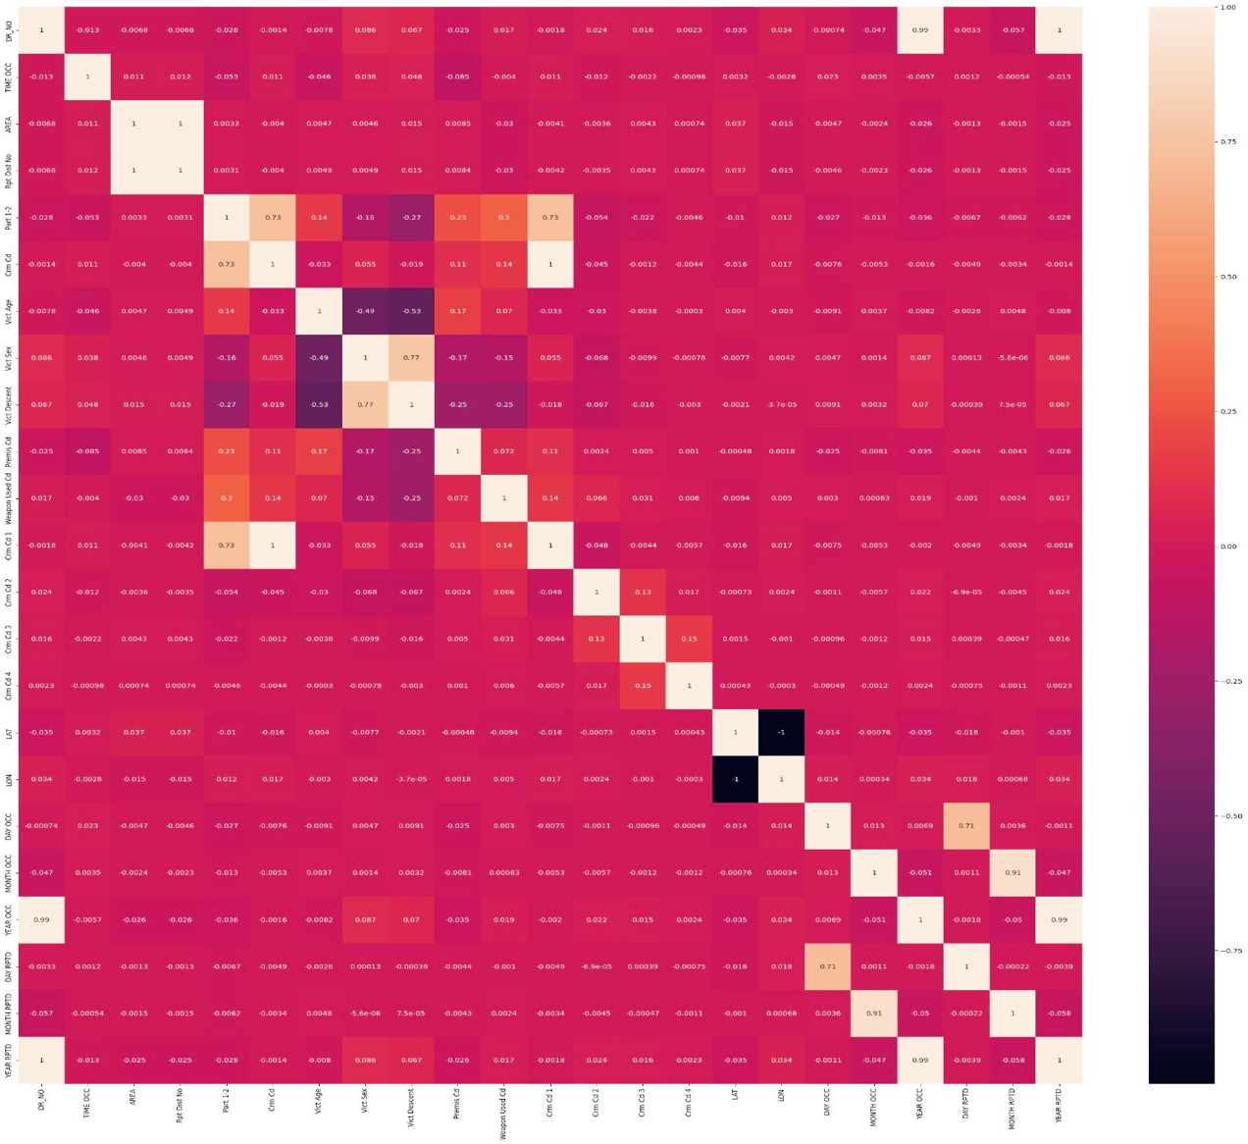
Feature engineering
We selected the features based on the correlation matrix, by running it with ‘AREA ’ as the target matrix.
We selected our features as –
['Rpt Dist No','LAT','Premis Cd','Vict Age','Vict Sex','Vict Descent','Time']

Slide 8
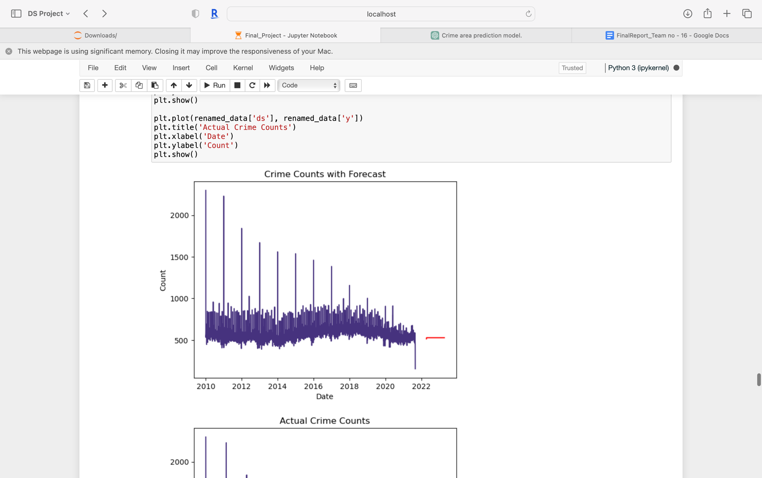
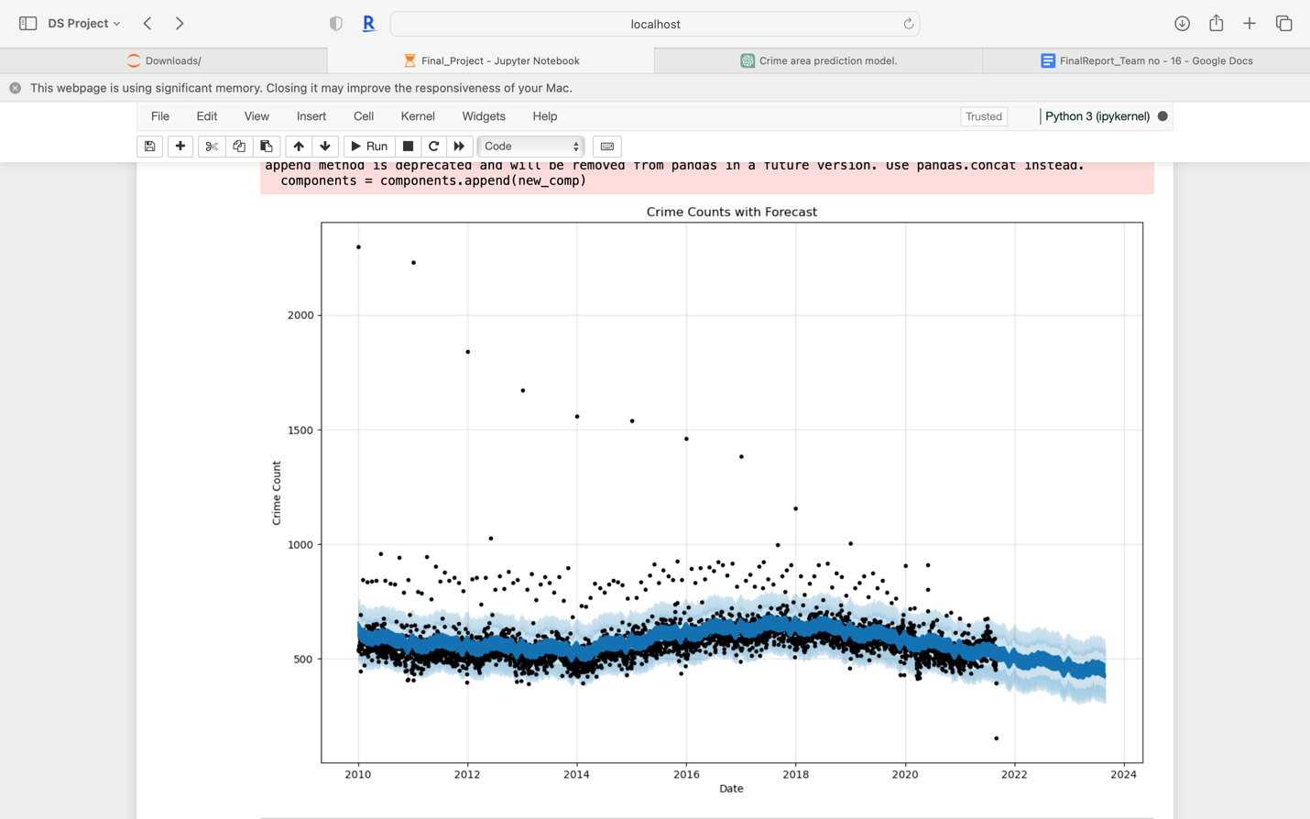
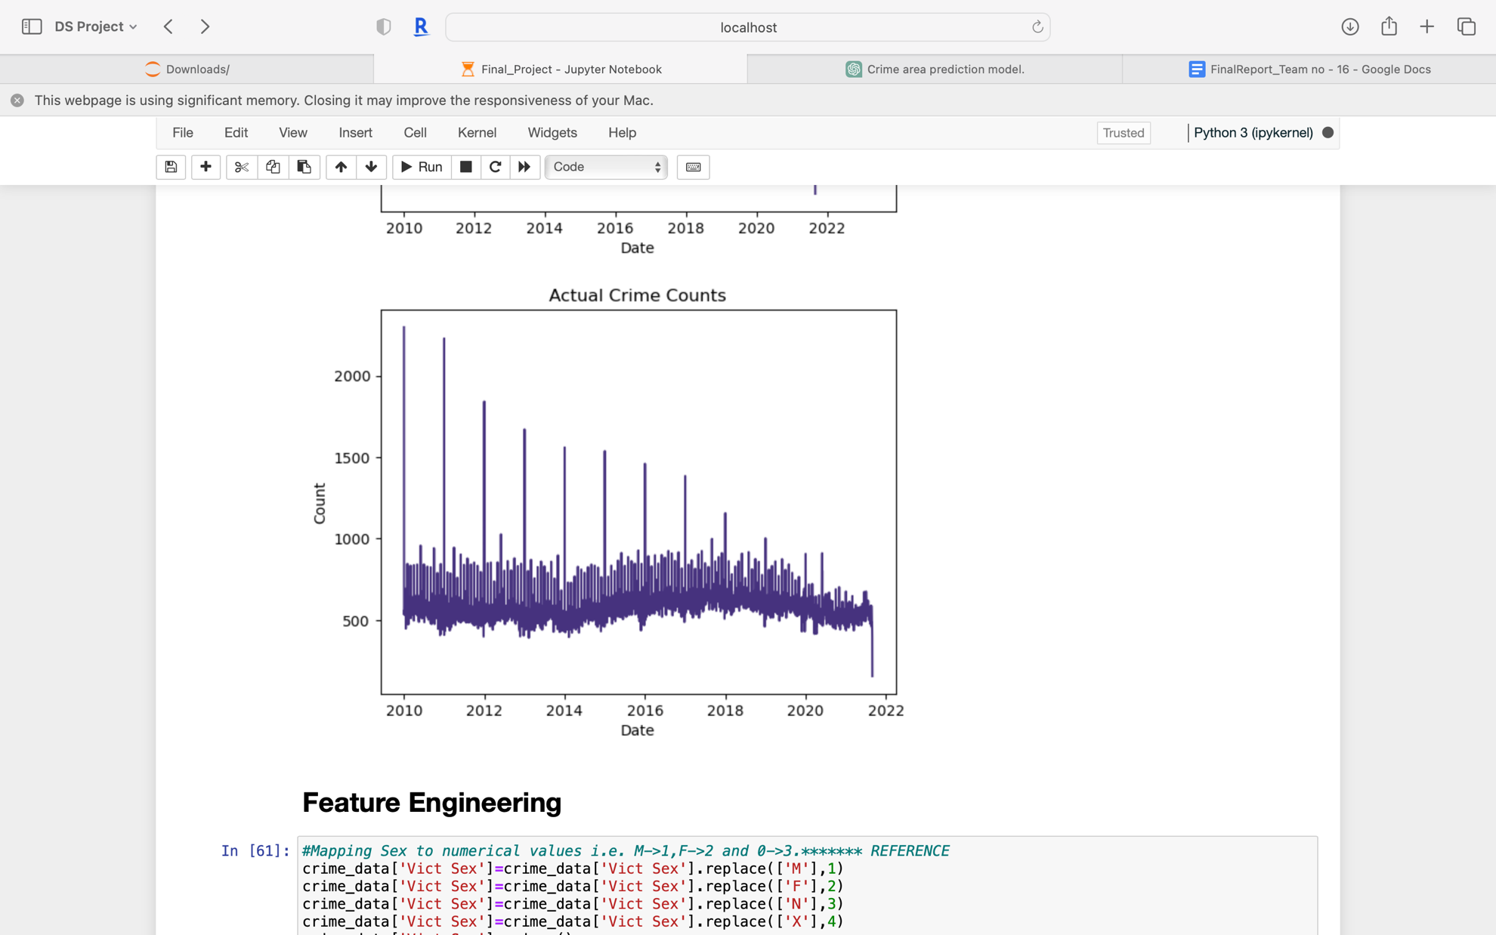
Time Series Analysis
Arima Model
Prophet Model

Slide 9
Model Selection
Logistic Regression
Random Forest Classifier
Decision Tree Classifier
Gaussian Naive Bayes

Slide 10
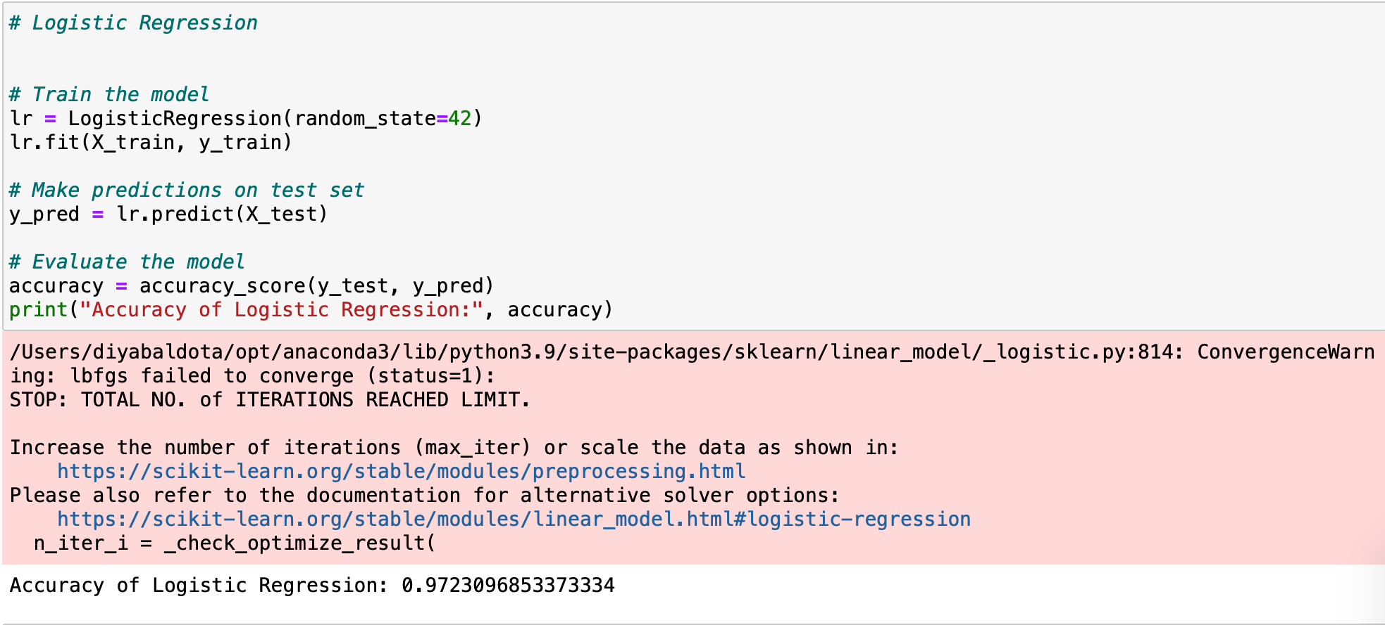
Logistic Regression

Slide 11
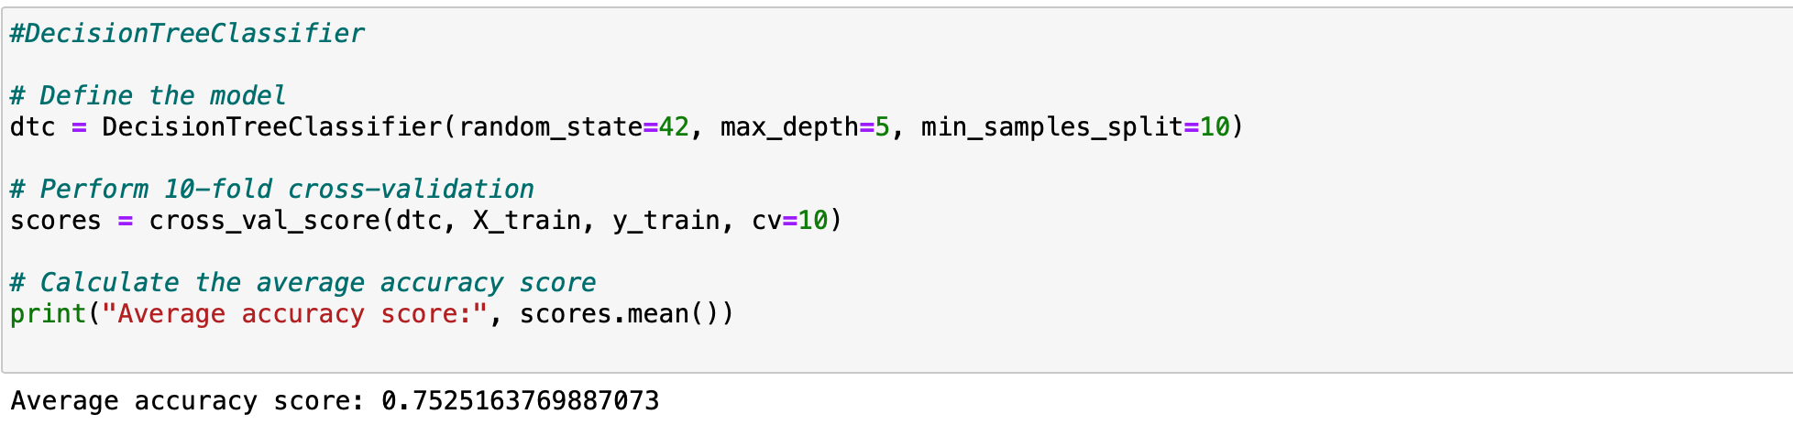
Decision Tree

Slide 12
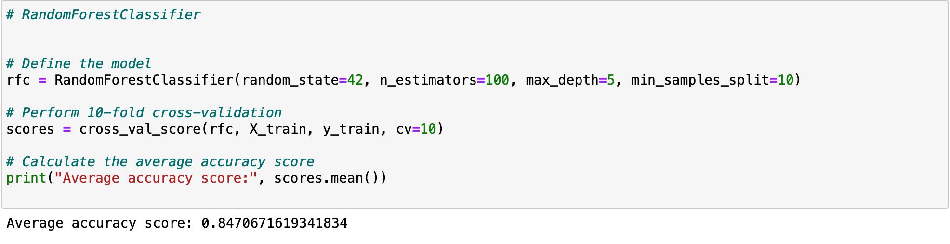
Random Forest Classifier

Slide 13
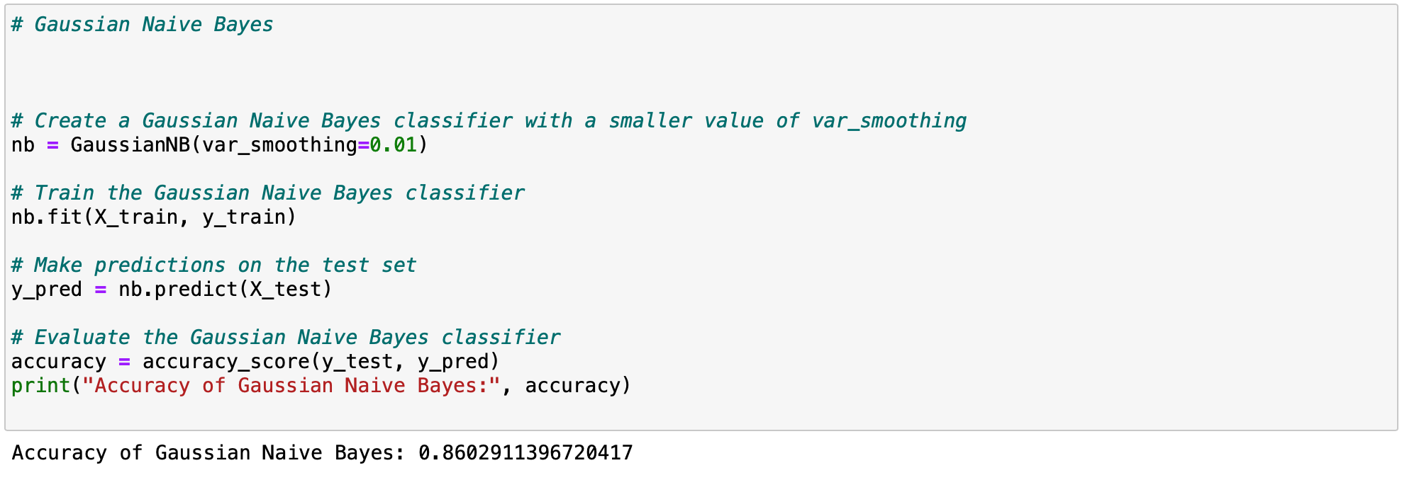
Gaussian Naïve Bayes

Slide 14
Conclusion
In summary, the code uses four different machine learning models to predict the geographic area of the crime. Each model is trained and evaluated using different methods and hyperparameters.
The models used are logistic regression, random forest classifier, decision tree classifier, and Gaussian Naive Bayes classifier. These models have their own strengths and weaknesses and may be more suitable for different types of datasets and problems.
It is important to evaluate multiple models and choose the best one based on their performance on different evaluation metrics.Based on the accuracy scores alone, the Logistic Regression model appears to be the best model for your analysis, as it has the highest accuracy score of 0.972

